Slide 1
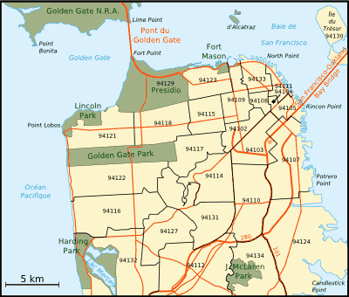

Data Analysis of San Francisco’s 311 Customer Service
April 18, 2020
Paul Pineda
James Ye
Tanvir Khan
Thanh(Travis) Le

Slide 2
Project Description
The 311 San Francisco platform serves as a tool to accept, process, and address various requests/complaints from the community, such as requests for city street cleaning, graffiti, potholes etc.
In this project we use the 311-call data from the City of San Francisco to determine the major concerns of residents:
Zip codes have the most 311 requests
Source was used the most to submit requests
If the month or day of the week affects the number of requests
To determine if there is any relation between the number of 311 calls per population, and income bracket.

Slide 3
Hypothesis:
We expect that there will be more complaints in the middle of the week (Wed-Thurs)
Higher Income will result in more 311 requests
Number of service request will increase with population
Number of service request will increase by shelter in place

Slide 4
Challenges:
•Finding relevant data from US Census Bureau
•Retrieving zip codes with Latitude and Longitude for each service requests
•Finding the valid zip code reference for City of San Francisco
•Combining data from different sources in a correct way
Data Cleaning:
•Use Pandas to remove unnecessary data from initial .csv file
•Use US Zipcode library to retrieve zip code for each latitude Longitude
•Removing invalid zip codes
•Merging all data frame to get final data frame for analysis and plotting
Data Sources:
https://sf311.org/information/reports
https://www.census.gov/data.html

Slide 5
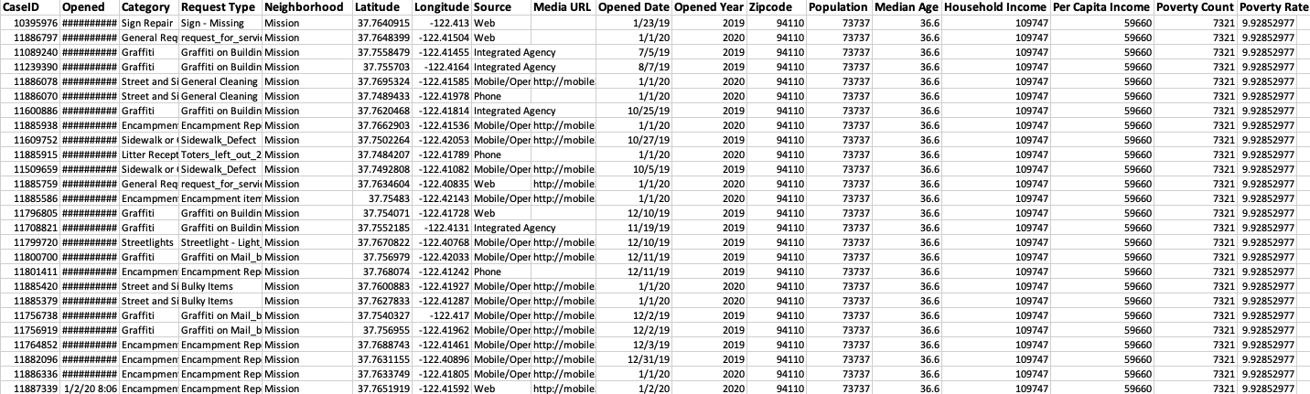

Final DataFrame
Data Collected - 2017 - 2020
Case Count 1,873,843
Source: team analysis based on (i) 311 call data from City of San Francisco (ii) Income and Population per zip code data form US Census of Bureau

Slide 6
Our analysis strategy
To do our analysis, we used:
Bar Chart
Pie Chart
Scatter Plot
Heatmap
Linear Regression
Statistical Analysis

Slide 7
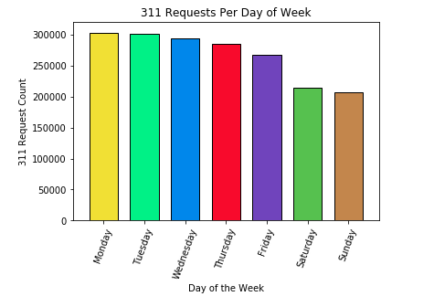
Hypothesis:
We expect that there will be more 311 cases during the middle of the week.
Call Count Per Day (2017-2020)
Source: team analysis based on (i) 311 call data from City of San Francisco (ii) Income and Population per zip code data form US Census of Bureau

Slide 8
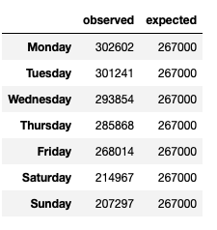
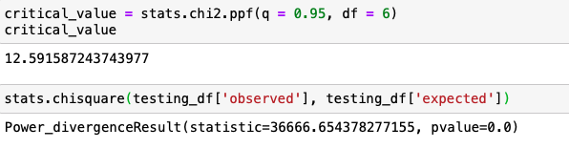
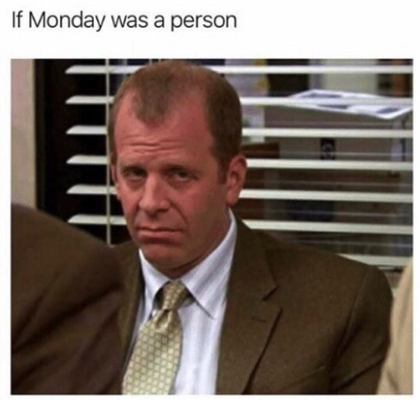
Hypothesis Testing:
Result:
Since the chi square value of 36,666.65 exceeds the critical value of 12.5, we conclude that the results are statistically significant.
Reject our Hypothesis:
More 311 Calls occured closer to the beginning of the week.

Slide 9
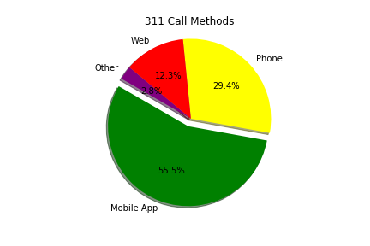


Data Visualization Cont.
311 Request Methods
Source: team analysis based on (i) 311 call data from City of San Francisco (ii) Income and Population per zip code data form US Census of Bureau

Slide 10
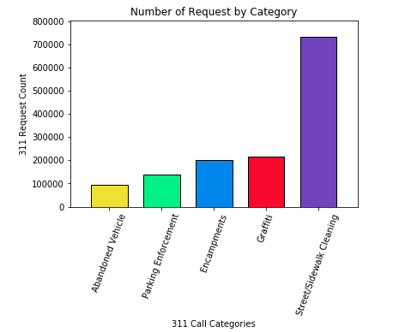
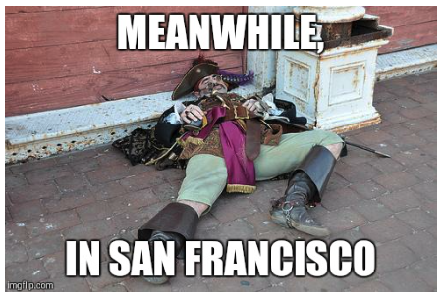

Data Visualization Cont.
Call Categories

Slide 11
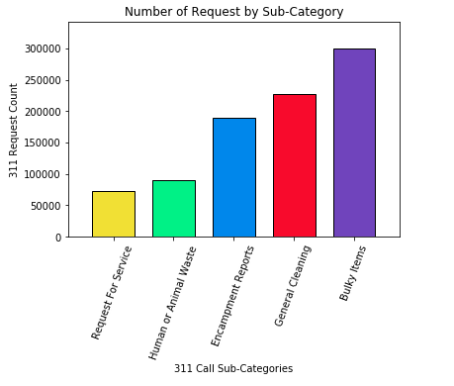


Data Visualization Cont.
Call Sub-Categories
Source: team analysis based on (i) 311 call data from City of San Francisco (ii) Income and Population per zip code data form US Census of Bureau

Slide 12


Hypothesis:
Middle of the week would be more requests
Higher income will result in more 311 requests
Number of service requests increase by population
Number of service requests increase by shelter-in-place

Slide 13
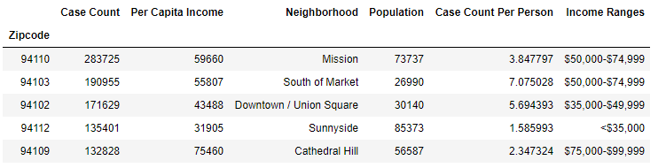
311 Requests vs Income

Slide 14
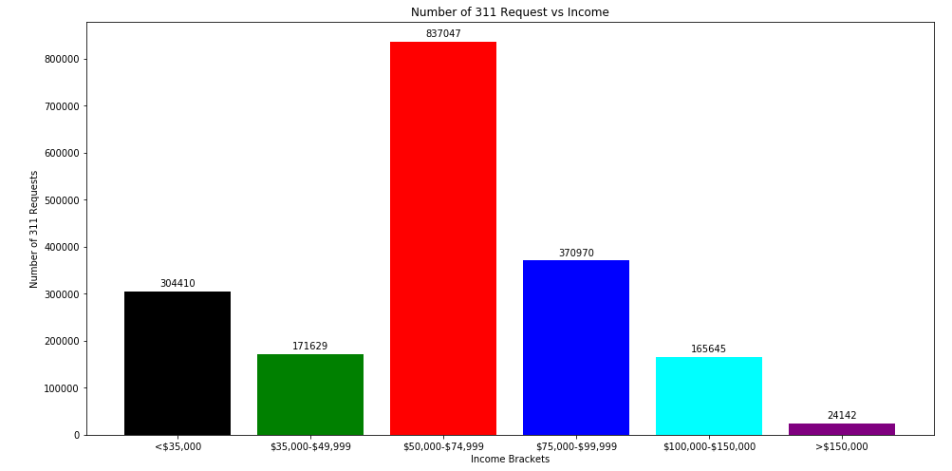
311 Requests vs Income
Source: team analysis based on (i) 311 call data from City of San Francisco (ii) Income and Population per zip code data form US Census of Bureau

Slide 15
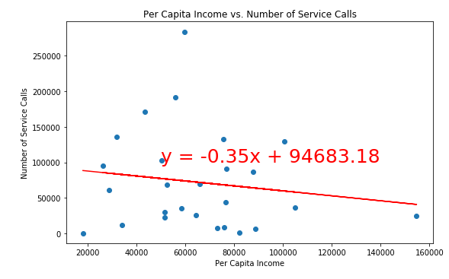
311 Requests vs Income
Correlation Coefficient: -0.1465
p-value: 0.475 (Accept Null Hypothesis)
Source: team analysis based on (i) 311 call data from City of San Francisco (ii) Income and Population per zip code data form US Census of Bureau

Slide 16
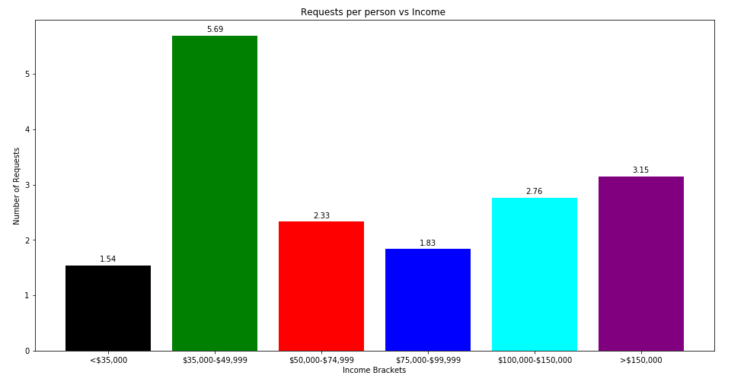
311 Requests vs Income
Source: team analysis based on (i) 311 call data from City of San Francisco (ii) Income and Population per zip code data form US Census of Bureau

Slide 17
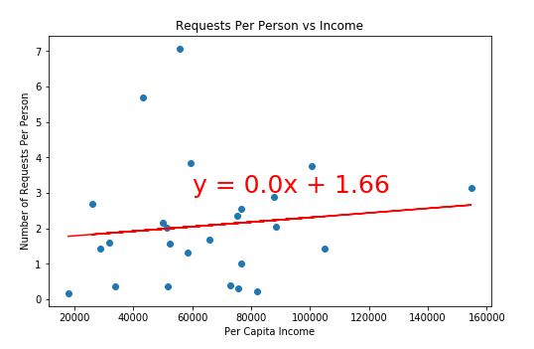
311 Requests vs Income
Correlation Coefficient: 0.114
p-value: 0.588 (Accept Null Hypothesis)
Source: team analysis based on (i) 311 call data from City of San Francisco (ii) Income and Population per zip code data form US Census of Bureau

Slide 18
311 Requests vs Income
Reject:
Higher income will result in more 311 requests
Most 311 Requests: $35k - $75k
Neighborhoods: Mission, South of Market, Tenderloin

Slide 19
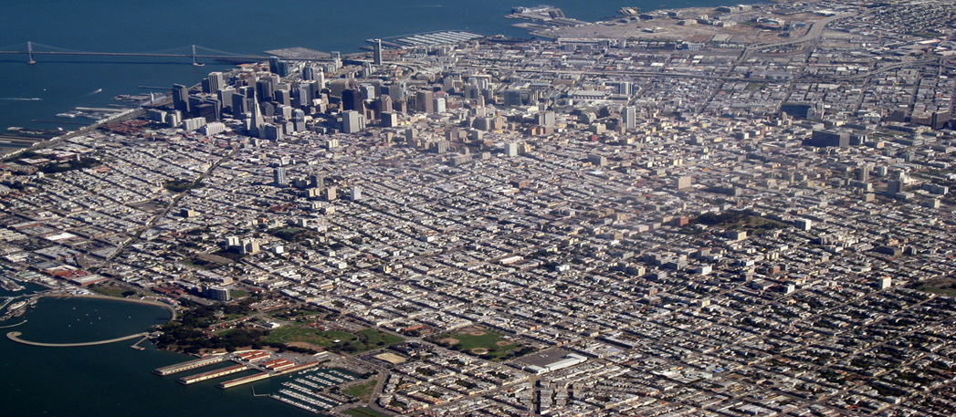
Hypothesis:
Middle of the week would be more requests
Higher income will result in more requests
Number of service requests increase by population
Number of service requests will increase by shelter-in-place

Slide 20
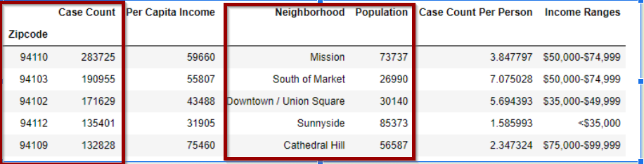
311 Requests vs Population for each Zip code
Source: team analysis based on (i) 311 call data from City of San Francisco (ii) Income and Population per zip code data form US Census of Bureau

Slide 21
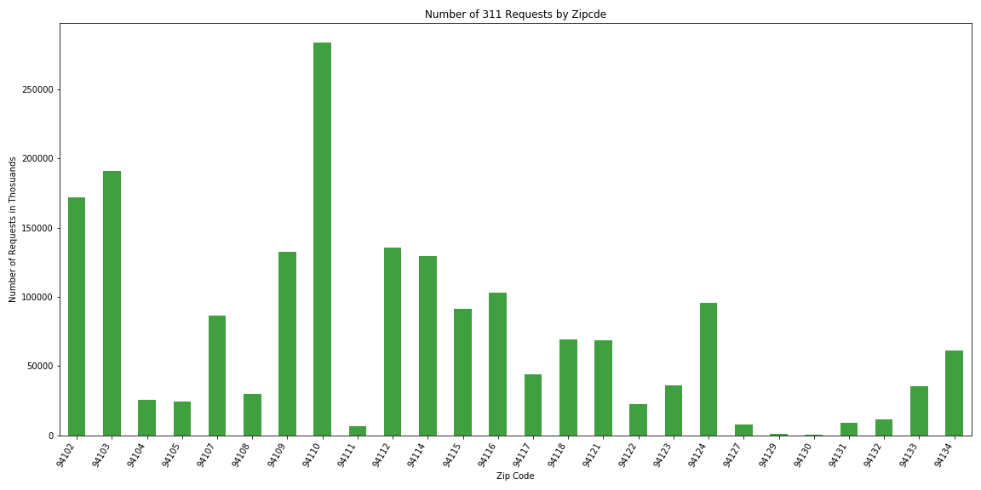
Number of Requests/Complaints per Zip code
The 94110 had the most request/complaint followed by 94103, and 94102, zip codes.
Mission
SOMA
Tenderloin/ Union Square
Source: team analysis based on (i) 311 call data from City of San Francisco (ii) Income and Population per zip code data form US Census of Bureau

Slide 22
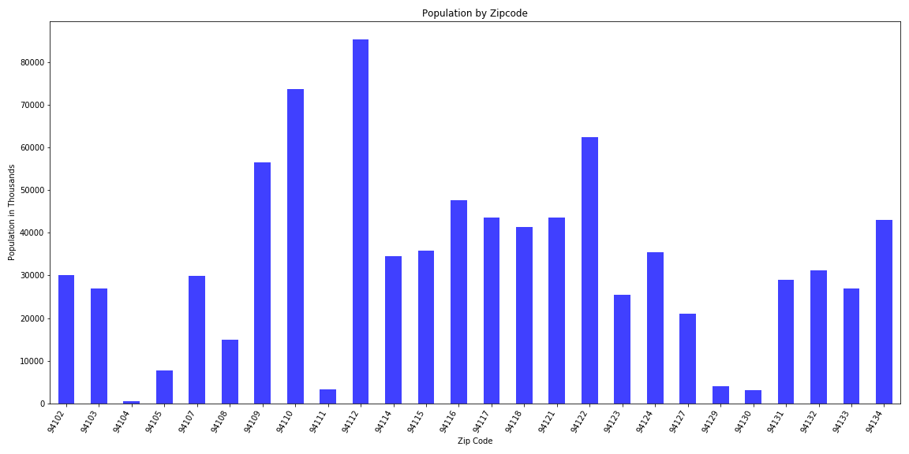
Population number per Zip code
The 94112 had the most population followed by 94110, 94122, and 94109 zip codes.
Sunnyside/ Outer MIssion
Mission
Inner Sunset
Russian/ Cathedral Hill
Source: team analysis based on (i) 311 call data from City of San Francisco (ii) Income and Population per zip code data form US Census of Bureau

Slide 23
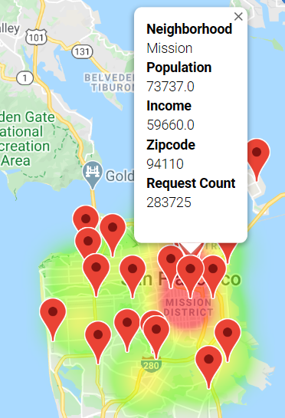
Visual Representation of 311 Requests/Complaints for each zip code as a heat map
Source: team analysis based on (i) 311 call data from City of San Francisco (ii) Income and Population per zip code data form US Census of Bureau

Slide 24
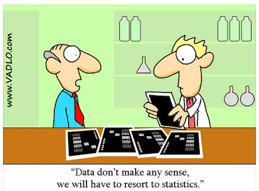
Hypothesis Testing
Hypothesis = If the population number is higher, then the number of service requests/complaints is higher in that Zip code
Null Hypothesis= The number of requests in a Zip code is not related to the number of population

Slide 25
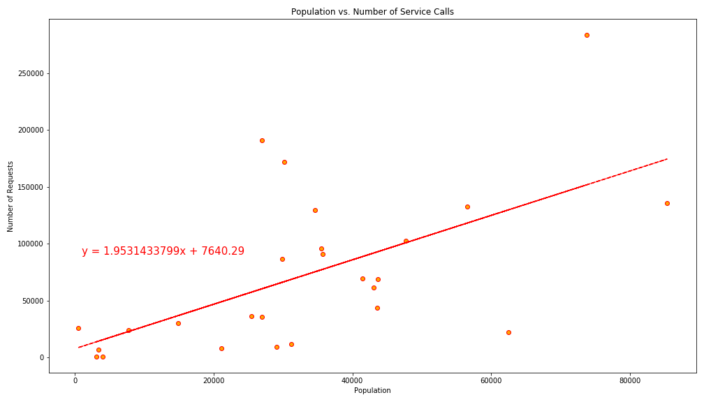
Is there any correlation between Number of 311 Requests and Population in each Zip code?
Correlation Coefficient = 0.60149
Correlation Determinant = 36.28%
p-value = 0.00115
Source: team analysis based on (i) 311 call data from City of San Francisco (ii) Income and Population per zip code data form US Census of Bureau

Slide 26
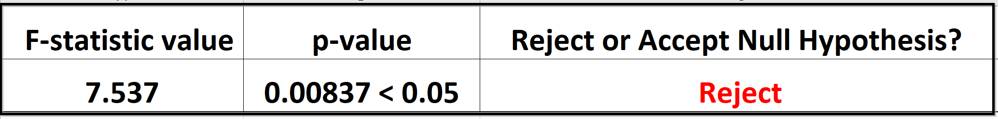
Statistical Testing - F Test
Is there any difference or relationship in between number of requests and population numbers in each zip code at 5% significance level?
Outcome: Rejecting our Null Hypothesis
The hypothesis is statistically significant at the 5% significance level.

Slide 27
Conclusion
From the bar plots, google heat maps, linear modeling, and statistical analysis shows the validity of our model and hence our hypothesis assumption is correct, if the population number is higher, then the number of service requests/complaints is higher in that Zip code.

Slide 28
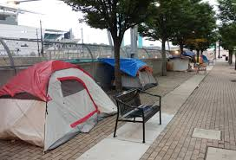

Hypothesis:
Middle of the week would be more requests
Higher income will result in more requests
Number of service requests increase by population
Number of service requests will increase by shelter-in-place

Slide 29
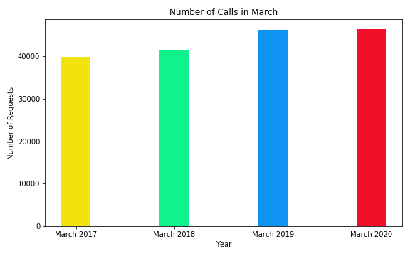
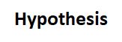

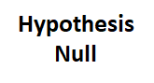

Hypothesis: Number of service requests increase by Shelter-In-Place
Chi Square | Pvalue | Critical Value = 3
793.968 | 8.796e-172 | 7.814
Source: team analysis based on (i) 311 call data from City of San Francisco (ii) Income and Population per zip code data form US Census of Bureau

Slide 30
Hypothesis Conclusion:
More complaints in the middle of the week (Wed-Thurs)
Higher income will result in more 311 requests
Number of service request will increase with population
Number of service request will increase by shelter in place
Source: team analysis based on (i) 311 call data from City of San Francisco (ii) Income and Population per zip code data form US Census of Bureau

Slide 31
Future Research:
These two datasets are extremely rich and much more research could be done
Incorporating more Census demographic data like age, ethnicity, and race, of the residents. This could have develop predictive models of complaints by population characteristics.
Monthly complaints or particular complaints could be broken down into neighborhood of some neighborhood are showing unresolved or increasing conditions at a different rate than the other neighborhood.

Slide 32




